Slide 1
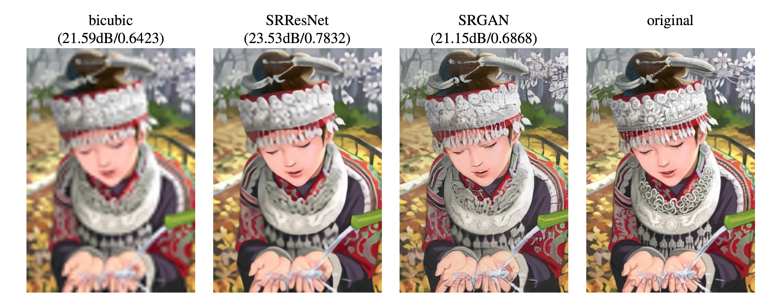
فرا تفکیک پذیری تصویر
Single Image Super-Resolution
استاد: دکتر محمدطاهر پیله ور
تهیه کننده : طاها سماواتی

Slide 2
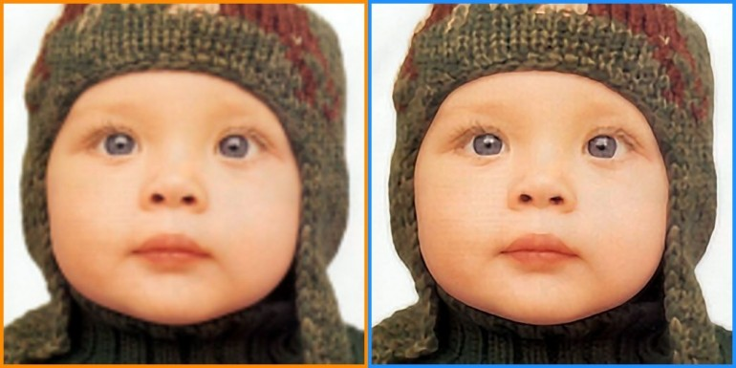
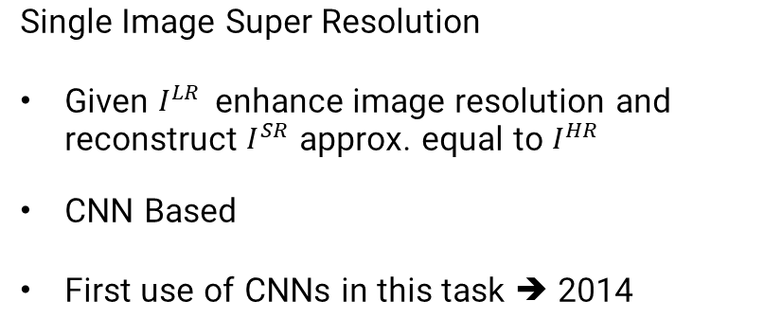
Introduction
Single Image Super Resolution
Given $I^{LR}$enhance image resolution and reconstruct $I^{SR}$ approx. equal to $I^{HR}$
CNN Based
First use of CNNs in this task ➔ 2014
Challenges
Network architecture
Loss function
Training procedure
Upsampling method
Real-time
Applications
Survillance and security
Sattelite images
Video and Image enhancement
Smartphones
Preprocessing for some applications to improve results
Paper
Photo-realistic single image super-resolution using a generative adversarial network. (2017) - ~ 3000 citations

Slide 3
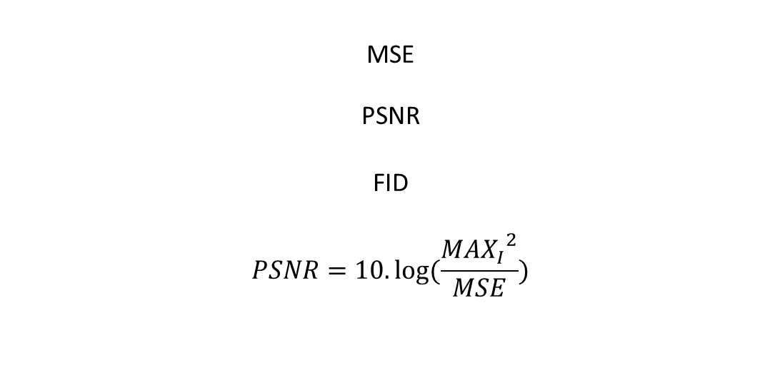

Introduction- Metrics
MSE
PSNR
FID
$$PSNR=10.log⁡(\frac{{{MAX}_{I}}^{2}}{MSE})$$
$$I\left(x,y\right)= \frac{2μ_{x}μ_{y}+c_{1}}{μ_{x}^{2}+μ_{y}^{2}+c_{1}} c\left(x,y\right)= \frac{2σ_{x}σ_{y}+c_{2}}{σ_{x}^{2}+σ_{y}^{2}+c_{2}}$$
$$s\left(x,y\right)= \frac{σ_{xy}+c_{3}}{σ_{x}σ_{y}+c_{3}}$$
Notes:
مقدار شاخص SSIM می تواند بین 1 و -1 تغییر کند. در صورتی که دو تصویر کاملا یکسان و مشابه باشند مقدار این شاخص برابر با 1 است. مقدار 0 نیز نشان دهنده اینست که دو تصویر با یکدیگر هیچ شباهت ساختاری ندارند. این معیار با اعمال پنجره لغزان 8*8 با گام 1 بر روی تصویر اعمال شده و یک نقشه از شاخص SSIM بدست می آید. اما برای کاهش هزینه محاسباتی مقدار گام بزرگتر انتخاب می شود تا از محاسبات تکراری و بیهوده جلوگیری شود.

Slide 4
Proposed Model – Improvement on SRGANs
Generator:
Same as SRGAN’s generator
With two additional residual blocks (a total of 18 RB)
InstanceNorm (*)
Discriminator
Fully Convolutional discriminator
8x lower parameter count
4M compared to 38M (SRGAN)
efficient to optimize

Slide 5
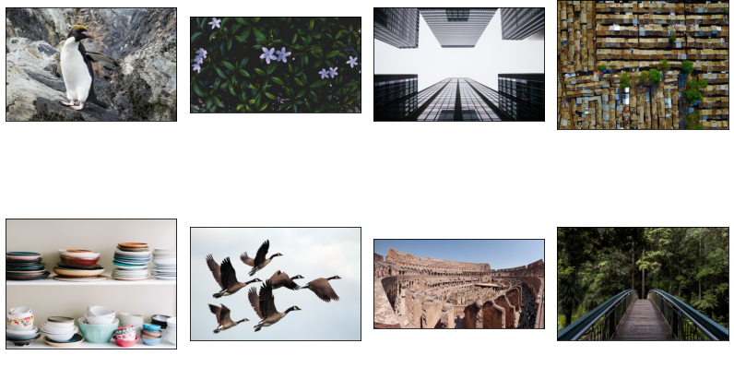
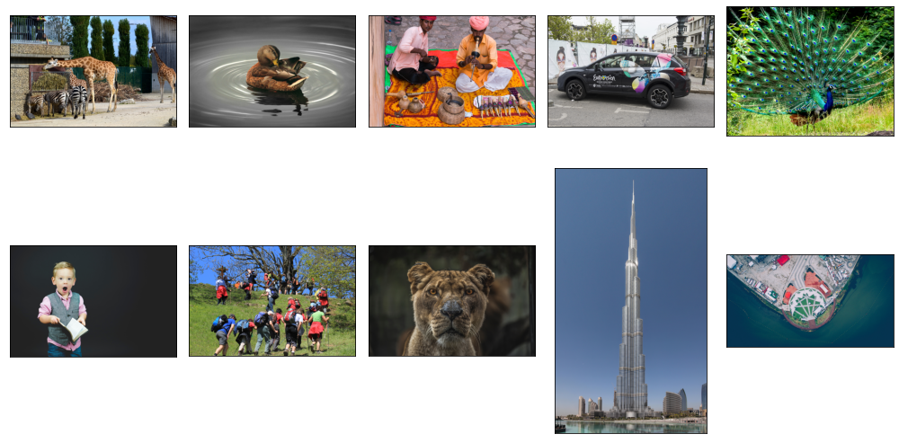
Dataset
Dataset
DIV2K ➔ 800 train – 100 validation (was used as test set)
Other benchmark datasets: Set5, BSD100, URBAN100
Preprocessing and Augmentation
0-1 Normalization (model built-in)
Random fixed sized cropping
Random rotation and flipping
LR images 4x downscaled (Bicubic)
Validation Train

Slide 6
Trainng Procedure
Training
Tensorflow 2 API
Generator: 4x upscale – with 1.7M parameters --- Discriminator 4M parameters
Batch size = 16 , Adam optimizer with constant decay
Trainnig procedure
Pretrain generator for some epochs with MSE loss
Adversarial training (50 000 steps)
Save weights every 1000 steps
Two models: 1. SRGAN 2.Improved SRGAN
Contribution: deeper generator by 2 resblocks + FCN discriminator 1/8 parameters + added DCT loss
Evaluation:
Compute MSE, PSNR, SSIM, FID on benchmark datasets
Visual

Slide 7
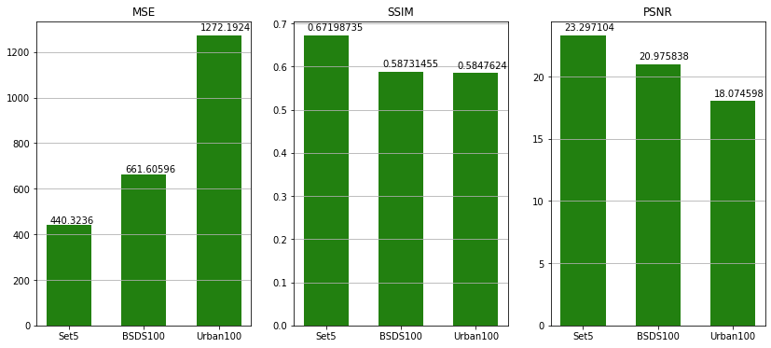
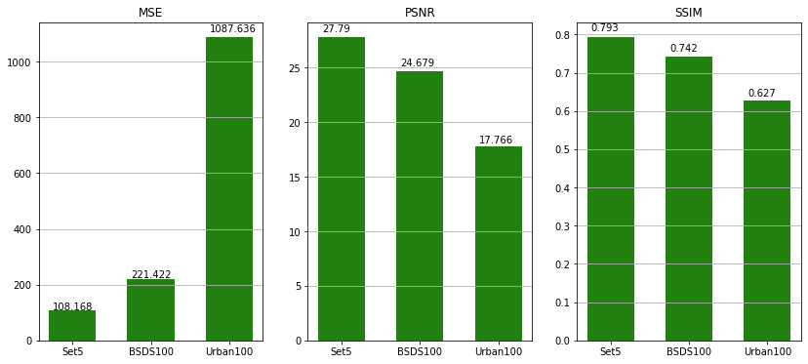
Results
SRGAN
16 Residual blocks
Traditional discriminator
Improved Model
18 Residual blocks
FCN discriminator
DCT loss
DIV2K - Validation
مدل / معیار | SRGAN Based | Improved SRGAN
MSE | 297.83 | 210.55
PSNR | 27.63 | 29.50
SSIM | 0.71 | 0.76

Slide 8
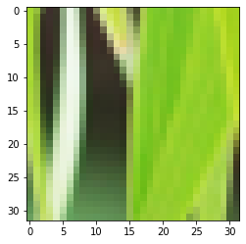
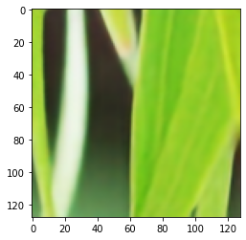
Overall Results
SRGAN – DIV2K_valid
Set5
BSDS100
Urban100
مدل / معیار | SR-ResNet-L2 | SR-GAN | Proposed – Improved SRGAN | Paper - SRGAN
MSE | 280 | 440 | 108 | ----
PSNR | 21.97 | 23.29 | 27.79 | 29.4
SSIM | 0.47 | 0.67 | 0.793 | 0.84
مدل / معیار | SR-ResNet-L2 | SR-GAN | Proposed – Improved SRGAN | Paper - SRGAN
MSE | 429 | 661 | 221.4 | ----
PSNR | 20.74 | 20.97 | 24.68 | 25.16
SSIM | 0.41 | 0.59 | 0.742 | 0.66
مدل / معیار | SR-ResNet-L2 | SR-GAN | Proposed – Improved SRGAN | Paper - SRGAN
MSE | 692 | 1272.2 | 1087 | ----
PSNR | 15.62 | 18.07 | 17.66 | ---
SSIM | 0.27 | 0.58 | 0.62 | ---

Slide 9
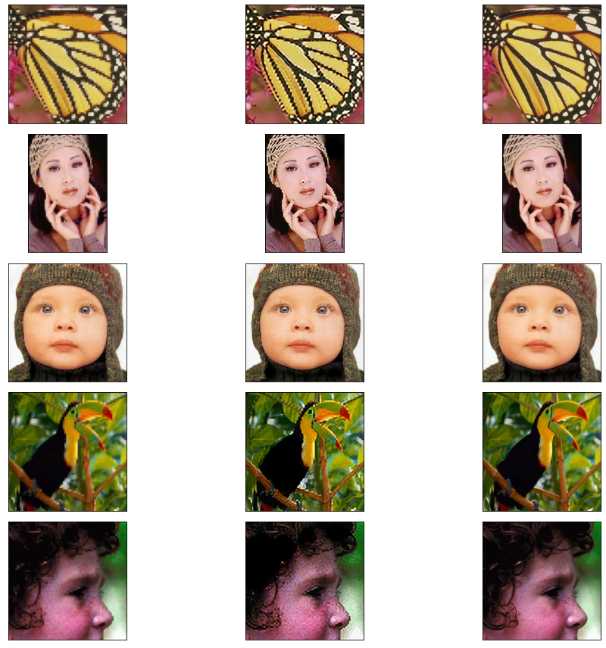
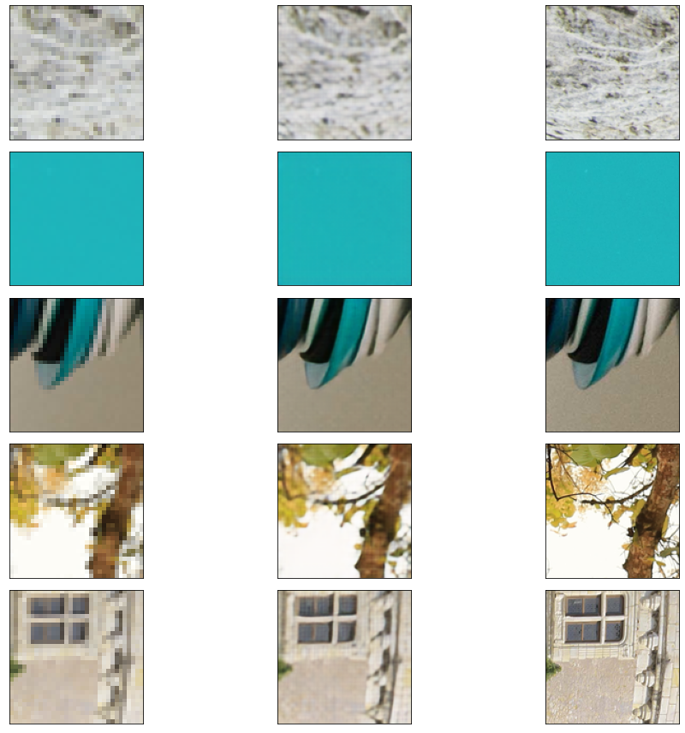
Results
Set5 DIV2K_VALID

Slide 10
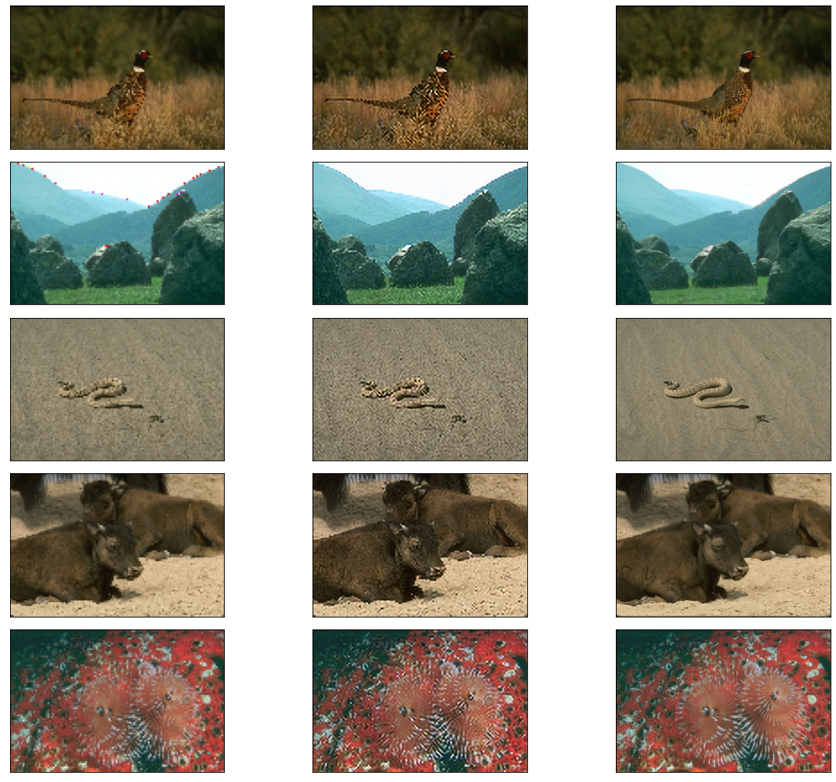
Results – BSD100

Slide 11
Thanks for your attention

